Slide 1
PREDICTING PROCEDURE TIMES

Slide 2
Problem
Medical procedure scheduling is often times mostly a crapshoot
It is very easy for procedures to get backed up, and waiting times of several hours for the patients, causing some to leave
Doctors can also be to fast, causing on missed opportunities to schedule extra patients
Procedures can be thousands of $ so scheduling well saves $

Slide 3
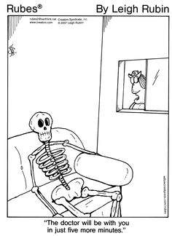

Slide 4
Objectives
Eventually I want to predict the total time in the room for each patient
This will be measured in minutes (Exit Room –Enter Room)
I will measure my score in RMSE

Slide 5
Data Source
I got my data from one Spinal Intervention Specialist at Fresno Surgery Hospital
The data is given in a clumsy text format which was a headache to clean, however eventually all data is mapped to a clean csv-file
Around 700 total procedures

Slide 6
Example of Data
DATE: 10/04/16 @ 1352 Fresno Surgical Hospital SCH LIVE PAGE 1
USER: GARBMI Procedure Times by Surgeon/Date with Patient Demographics
Date Account Number Age Gender ASA Class BMI Procedure Name Into Rm Start End Procedure Time Out of Room
01/04/16 V185428 64 F 34.0 LEFT LUMBAR MEDIAL BRANCH RADIOFREQUEN.. 1123 1137
Coded Allergy:
NO KNOWN DRUG ALLERGIES
CODEINE
ASPIRIN
Uncoded Allergy:
CPT Code ICD-10 Code Insurance
64635 M47.816 BLUE SHIELD HMO
64636 G54.4
M51.36
M51.06
M96.1
M54.16
M12.88
I10
Z98.89

Slide 7
Features
Procedure: The type of procedure being formed, aka Facet Joint Injection
CPT Codes: What the doctor actually bills for and gets paid for, can be multiple codes per procedure
Demographic Data –AKA Age, Gender etc..
Specific procedure Data, AKA What was the month of the procedure, was there one or two rooms available

Slide 8
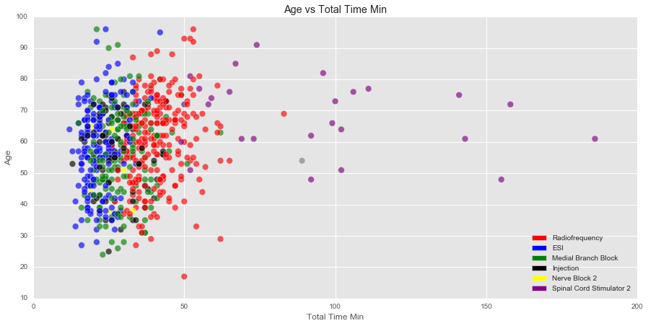

Slide 9
Average values and Null Accuracy
Average Time: 34.18 MIN
Null score is using the average value:
RMSE : 17.0352177771
ABS: 11.0595509957
Null Score using average lengths of procedures:
RMSE: 10.234851065
ABS: 6.62104695097

Slide 10
Algorithm Selection
Simpler algorithms like KNN and Linear Regression Seem to work better then more complicated algorithms like Random Forest
This is most likely due to the relatively small amount of data I have available
Eventually I narrowed in on 3 main algorithms: KNN, Linear Regression and SGD and ensembled combinations of all three

Slide 11
Feature Selection
To select my features I used stepwise feature selection, which means selecting the K Best feature for 1 feature – through my total list of features.

Slide 12
Ensemble creation
I used the predictions of some combination of Linear Regression, KNN and SGD as features which I fed into a another KNN, SGD or Linear Regression Algorithm
KNN
K Best Features
Linear Regression
KNN, SGD or Linear Regression
Final Predictions
SGD

Slide 13
Algorththm 1

